Slide 1
Hacked at 80 MPH
Cyber Security concerns in the connected vehicle
By: Alejandro J. Restrepo

Slide 2
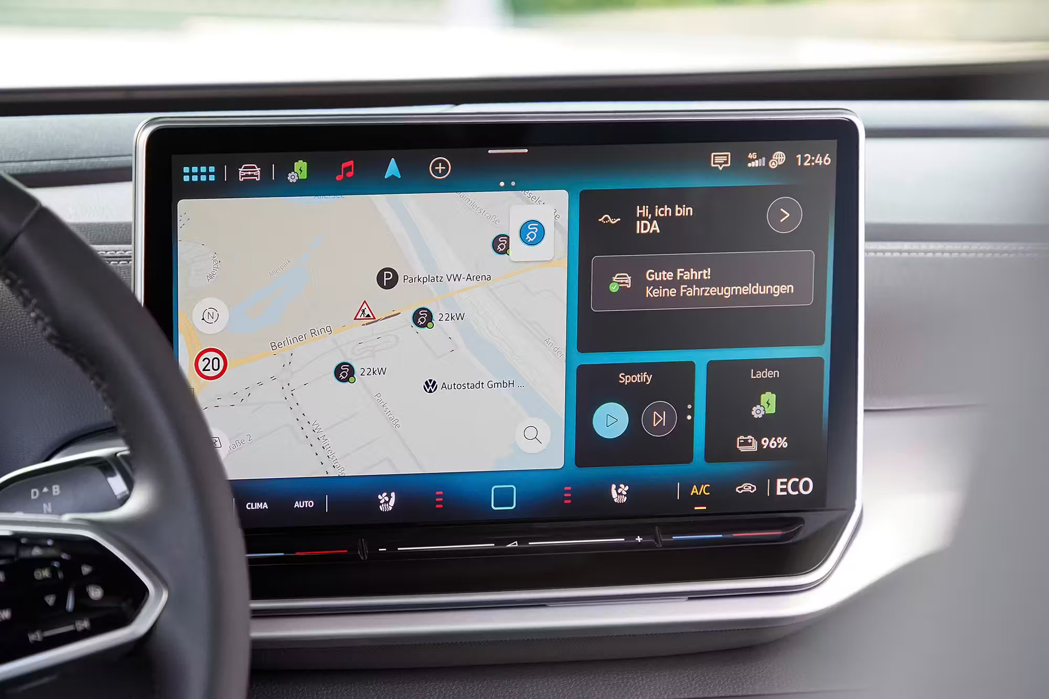
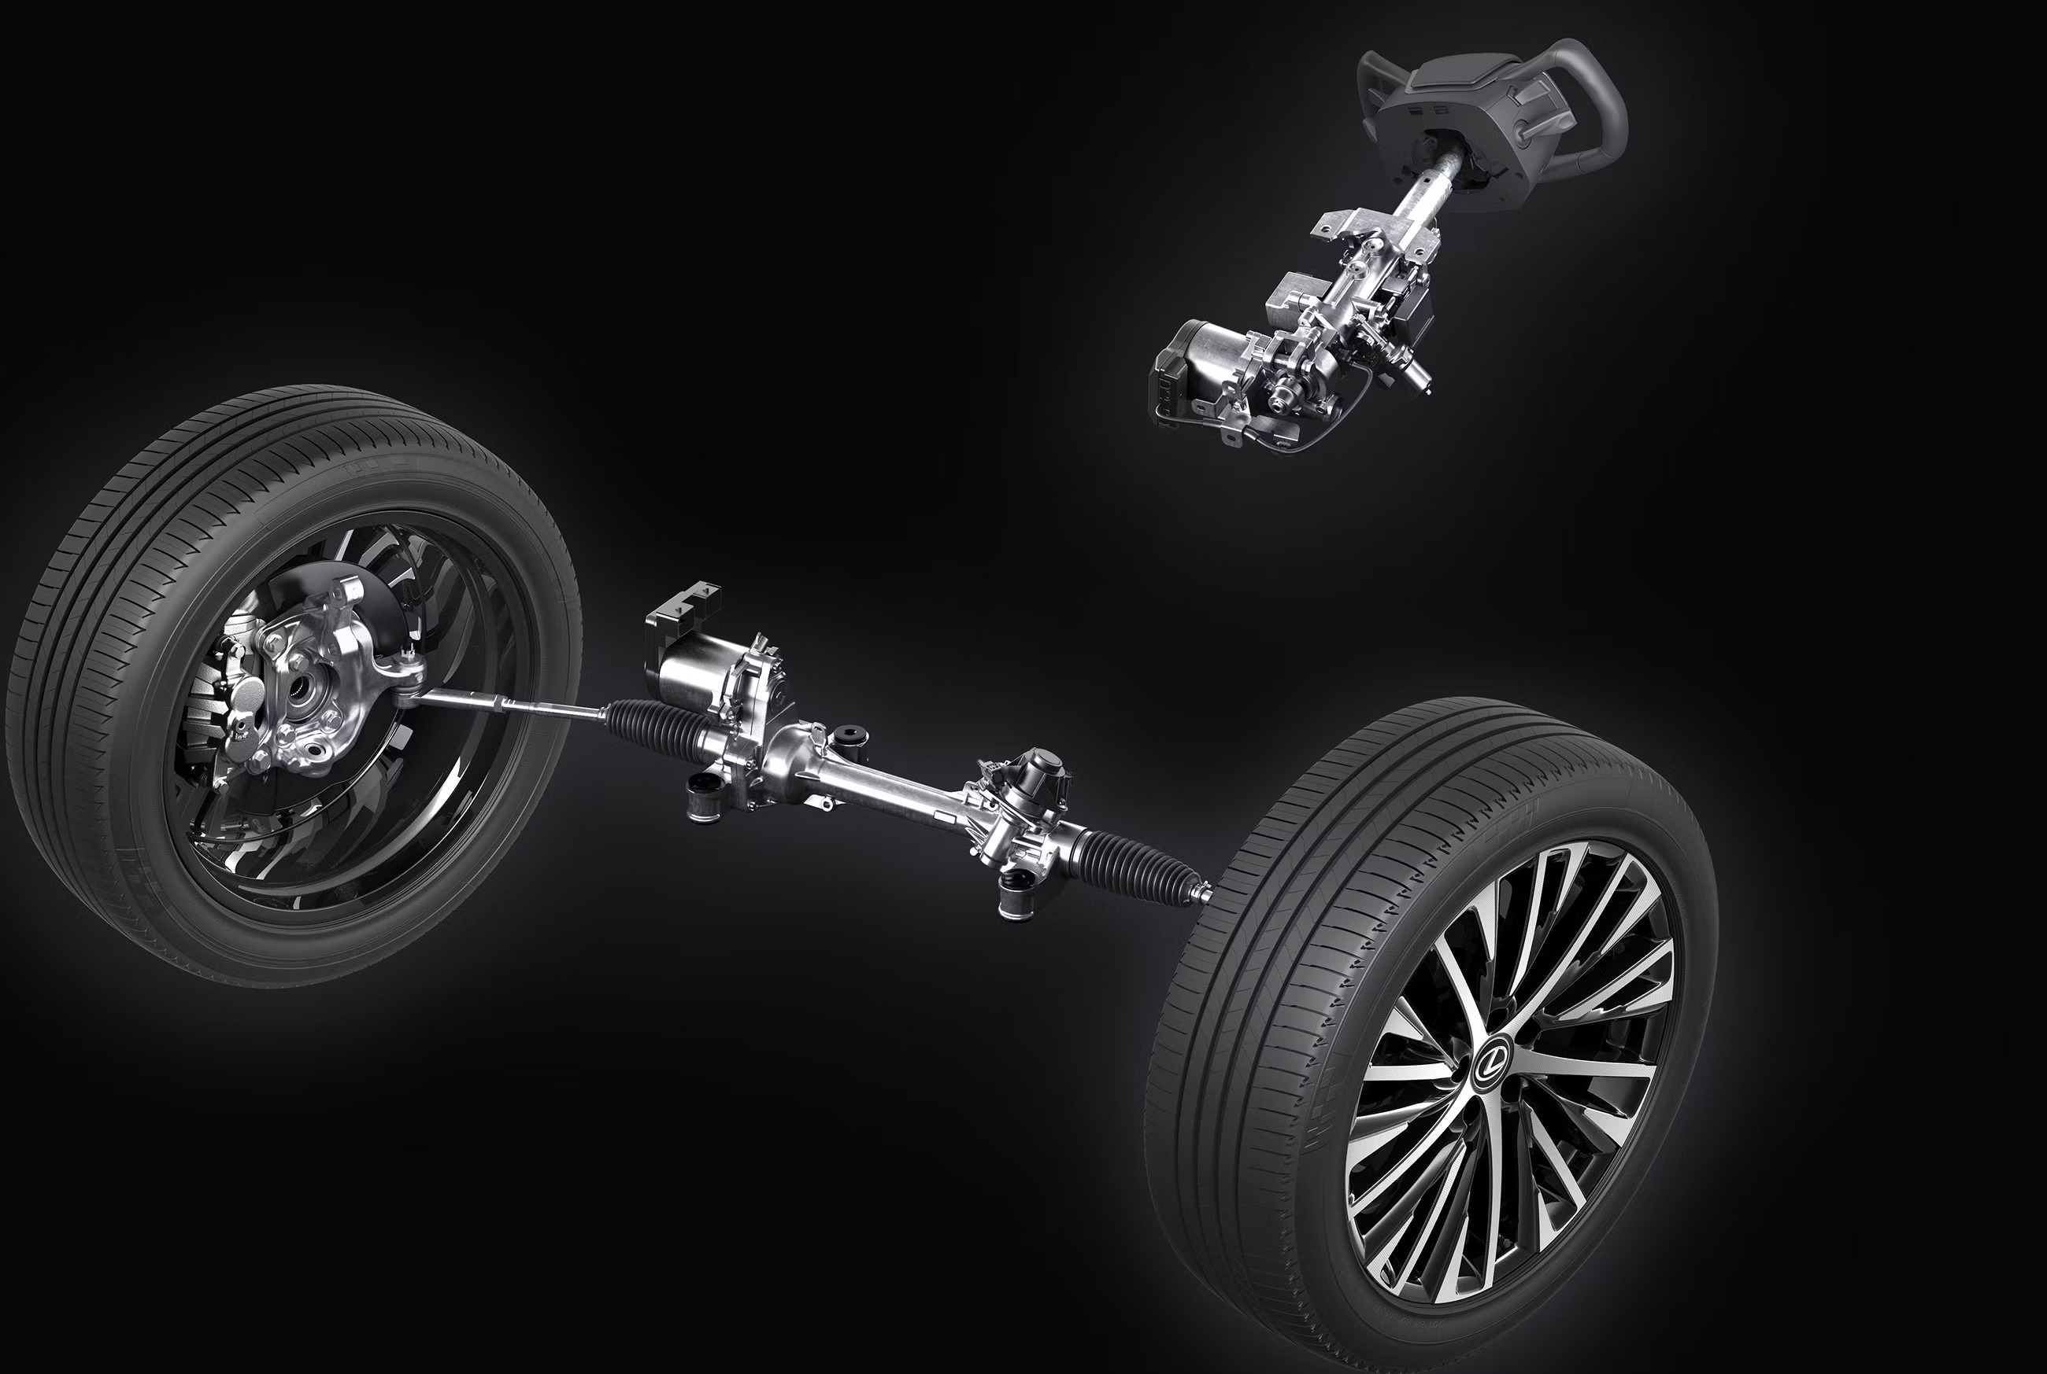
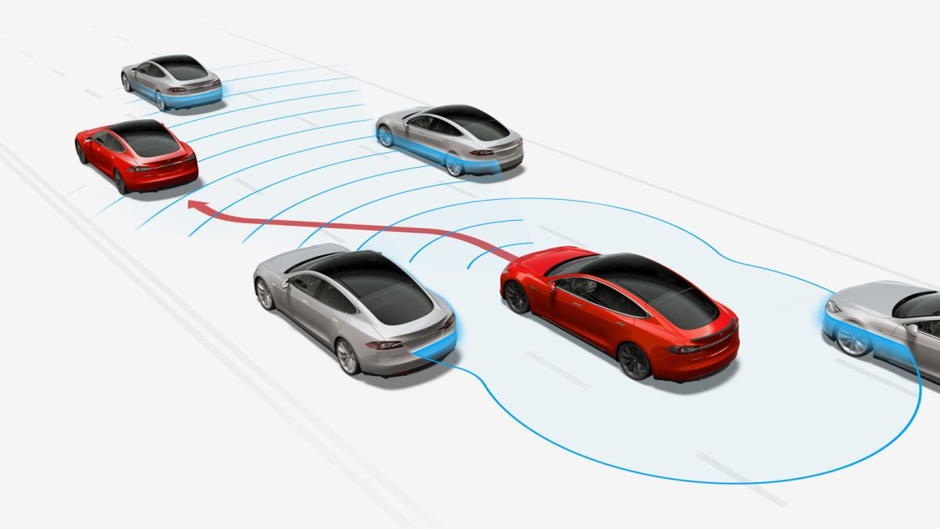
Key Concepts:
Infotainment System: Central Screen serving as a vehicle’s radio.
Steer By Wire: Steering using no physical components only electric motors.
Auto Navigate: Systems which take over all control of the vehicle while cruising.

Slide 3
Are you safe?
If your vehicle is on this list, you are vulnerable
GM: OnStar: 2011 to Present
Volkswagen: CarNet: 2013 to Present
Toyota/Lexus: EnTune: 2012 to Present
Kia/Hyundai: Blue Link: 2012 to Present
Ford: Sync: 2008 to Present
Honda: Honda Link: 2013 to Present

